Slide 1

BetterSwipe
“Better Rewards, Better Savings, Better Swipe”
BLUE TEAM FALL 2023
Design Presentation
CS410

Slide 2
Table of Contents
Choosing a Credit Card Today | #2-4
The Problem | #5-10
Better Swipe | #11-15
Work BreakDown Structure | #16-18
Algorithms | #19-23
Database | #24-25
Development | #26-29
Risk/Mitigations | #30-32
Competition and Constraints | #33-34
Conclusion | #35-36
References | #37-40

Slide 3

The Team
Cody
Cochran
Algorithm Design
Database Management
Devin
Morgan
Frontend Developer
UI Designer
John
Cartwright
Full-Stack Developer
Kyrie
Champagne
Document Specialist
Backend Developer
Marcelo
Vargas
Webmaster
Algorithm Design
Notes:
Sources: Evans, D. S., & Schmalensee, R. (2005). Paying with Plastic: The Digital Revolution in Buying and Borrowing. MIT Press.

Slide 4

There are too many rewards cards
Too many rewards cards to choose
Credit Karma: 116 (2023)
Nerd wallet: 85 (2023)
Lots of rewards cards make it hard to choose
There are 13 criteria to compare rewards credit cards with (NerdWallet, 2023)
61% of people are overwhelmed by the options (Experian, 2017)
69% of reward credit card holders are underutilizing their rewards (Lambright Black, 2023)

Slide 5
🍎🍊Comparing Apples to Oranges🍎🍊
* Top 3 credit cards of each reward type according to NerdWallet (5)
 | Wells Fargo Active Cash | Capital One Venture | Chase Sapphire Preferred
Rewards on any purchase per dollar spent | 2% cash back | 2 miles | 2 points
Rewards on food/groceries | 2% cash back | 2 miles | 3 points
Rewards on proprietary affiliate purchases | 2% cash back | 5 miles | 5 points

Slide 6
Rewards from a 1 Week Trip:
$500 plane ticket (Delta), $860 hotel (Holiday Inn), $300 car rental (Hertz)
Wells Fargo Active Cash Card
2% cash back on total price = $16.60
Chase Sapphire Preferred Card
5x points on hotel (IHG partner) (4300 points)
2x points on flight / car rental (1600 points)
1.25¢ per point: 5900 points total = $73.75
Capital One Venture Card
5 miles on hotel / car rental purchases (5800 miles)
2 miles on flight (1000 miles)
1¢ per mile: 6800 miles total = $68.00
How would results change if other purchases were factored?

Slide 7
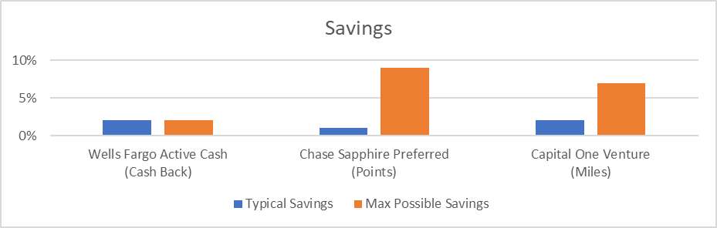
Savings Based on Spending Habits
Chase Sapphire Preferred
Typical: $1 → 1 pt → $0.01 (cash)
Max: $1 (Chase Travel) → 5x pts → 5x $0.018 (Virgin Atlantic Flying Club)
Capital One Venture
Typical: $1 → 2 miles → 2x $0.01 (cash)
Max: $1 (hotel/car rental) → 5 miles → 5x $0.014 (Air Canada)

Slide 8
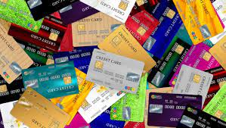
Rewards Cards Can Save You Money
Consumers have a significant potential in savings through the use of rewards credit cards, but choosing the right card to maximize their savings is complicated.
usatoday.com
8
Notes:
Image Sources:
https://www.usatoday.com/money/blueprint/credit-cards/how-many-credit-cards-should-i-have/

Slide 9

The Rewards Card Selection Conundrum
Consumers need to manually determine best card for them based on spending profile
Determining rewards value is challenging:
3 rewards systems (cash, points, miles)
Amount of reward depends on expense type (travel, food, etc.)
True value of rewards can vary based on how they are redeemed
Consumers’ intended purchases should be a selection consideration

Slide 10
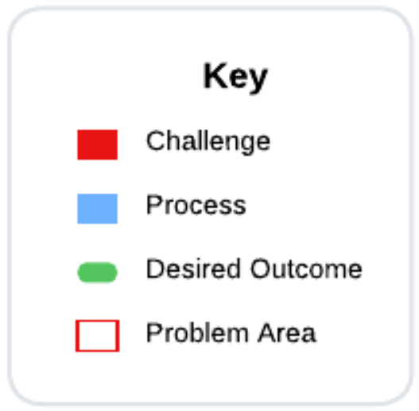
Drowning in Research and Decisions
User wants to obtain a rewards credit card
User analyzes spending habits
User reads up on the rewards of one out of hundreds of cards
No
User estimates how much card could save them
If card is better than current best, note it as the new best
Exhausted yet?
User must begin researching hundreds of cards
Yes
Are rewards leading to saved money?
Obtain card
Continue analyzing expenses
Yes
Card is a good match
Yearly/bi-yearly self review
No

Slide 11
Solution Statement
BetterSwipe is a tool that provides individuals who are seeking to maximize their savings through the use of rewards credit cards by helping them make an informed decision based on their spending profile.

Slide 12
Solution Characteristics
Build a spending profile from previous transactions.
Continuous monitoring of expenses
Recommend rewards credit cards based on the spending profile
Take the analysis work away from the user
Simplifies the reward card selection process
Notes:
Image source:
https://www.quicken.com/goals/see-where-my-money-is-going/
businesswoman-relax-from-work-at-the-office.jpg

Slide 13
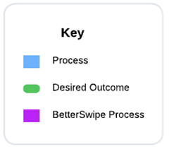
I’d rather Multiple Choice than Fill in the Blank
User wants to obtain a rewards credit card
BetterSwipe analyzes spending habits with bank/card statements and builds a spending profile
Credit card database is searched
Card savings are calculated based on spending profile
Cards with best calculated savings are suggested to the user
User looks between only a few cards
BetterSwipe continues to analyze expenses and update spending profile
Are rewards leading to saved money?
User obtains card
No
Card is a good match
Yes

Slide 14
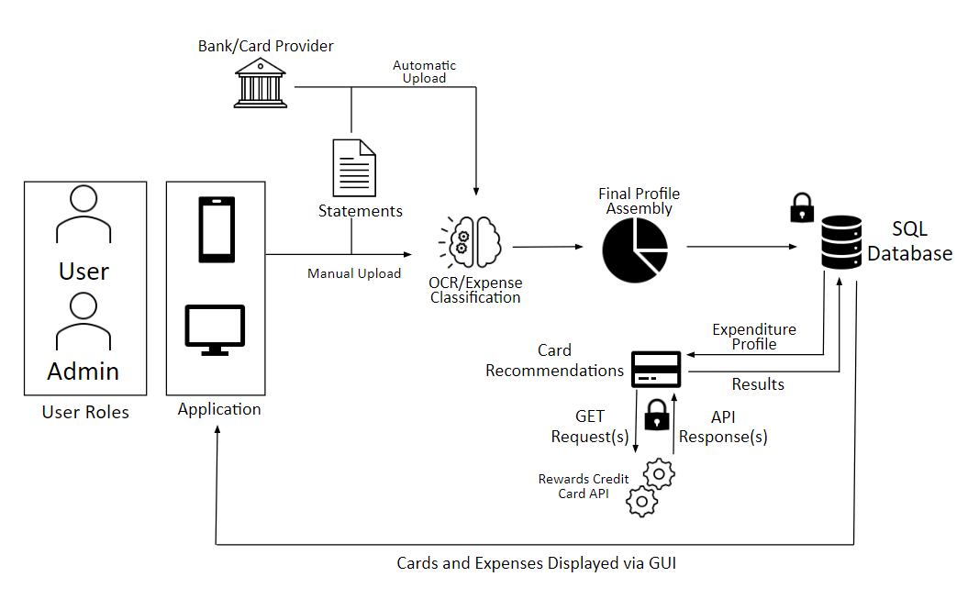
Major Functional Component Diagram
Notes:
Sources: https://shourai.io/blog/2020/07/17/web-application-development-the-basic-concepts/
https://www.allerin.com/blog/what-is-mobile-app-integration

Slide 15
User Roles
New Credit Card Users
Users who are skeptical of credit cards
Wants a handful of meaningful options
Experienced Credit Card Users
Users who want unbiased card recommendations
Looking for real, data-based reward card options
Admins
Users needing elevated privileges for testing and development

Slide 16
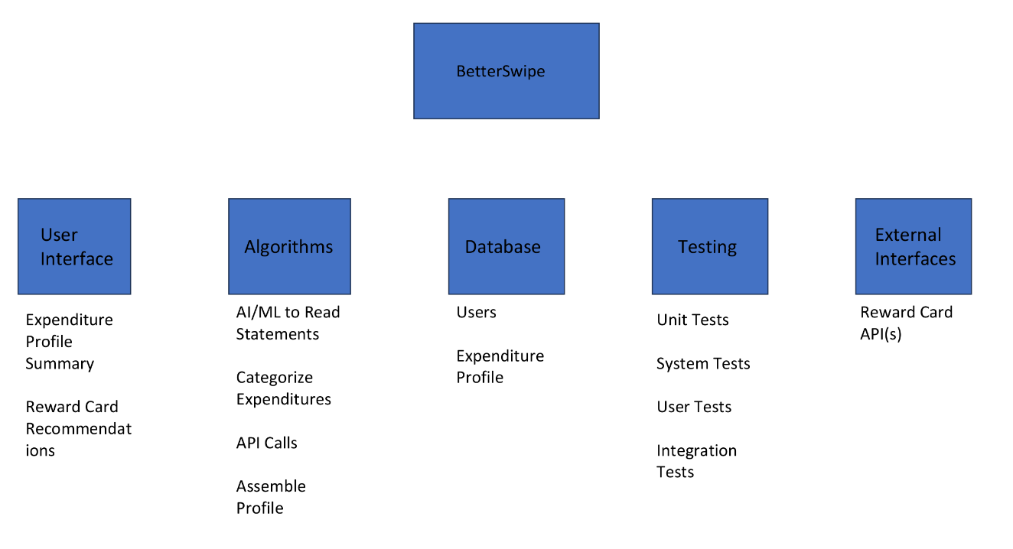
Work Breakdown Structure Overview
BetterSwipe
User Interface
Algorithms
Database
Data Management
Testing
UI Flow
Account Setup
User Data
Sources
Hardware
Mockups
Update Spending Profile
Spending Profile
Storage
Software
Find Top Matches
Rewards Cards
Backup
Security

Slide 17
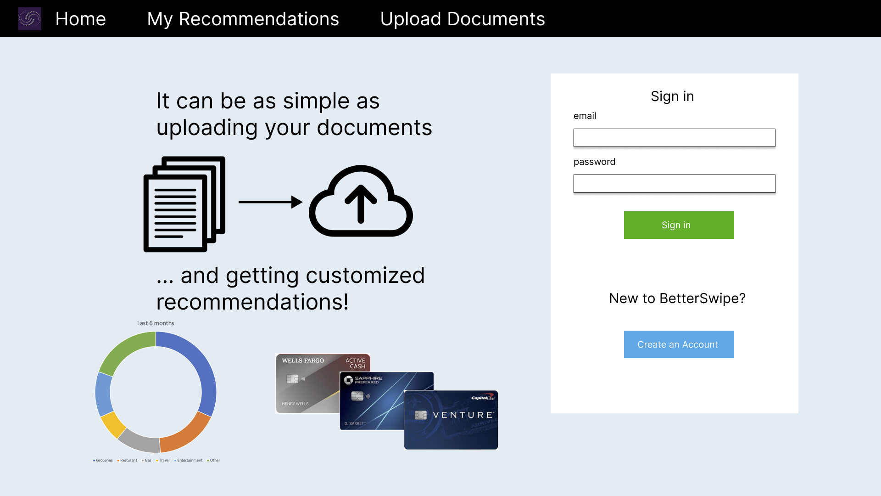
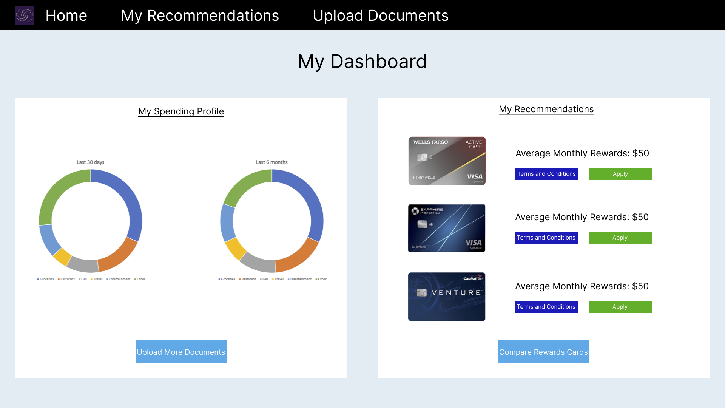
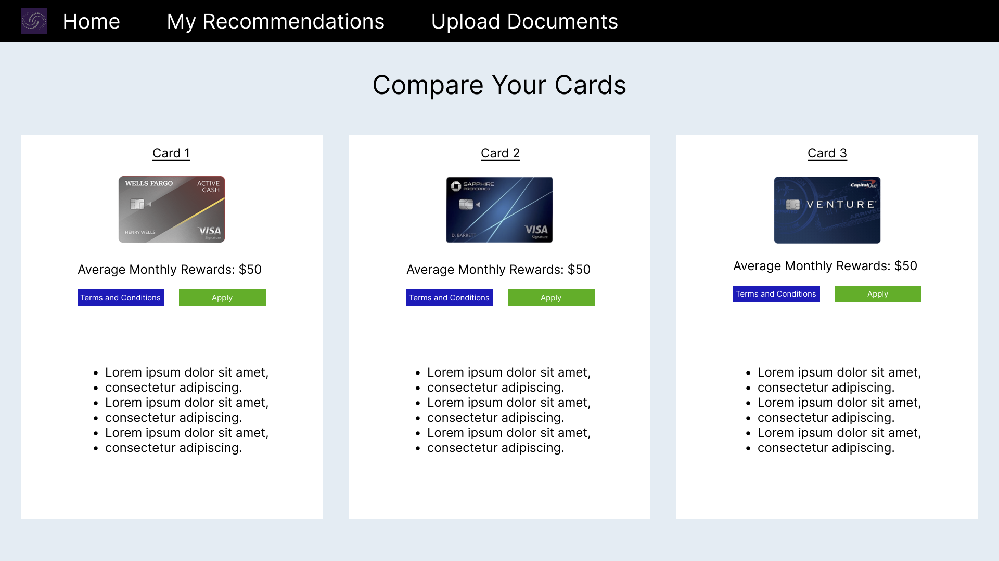
General Pages

Slide 18
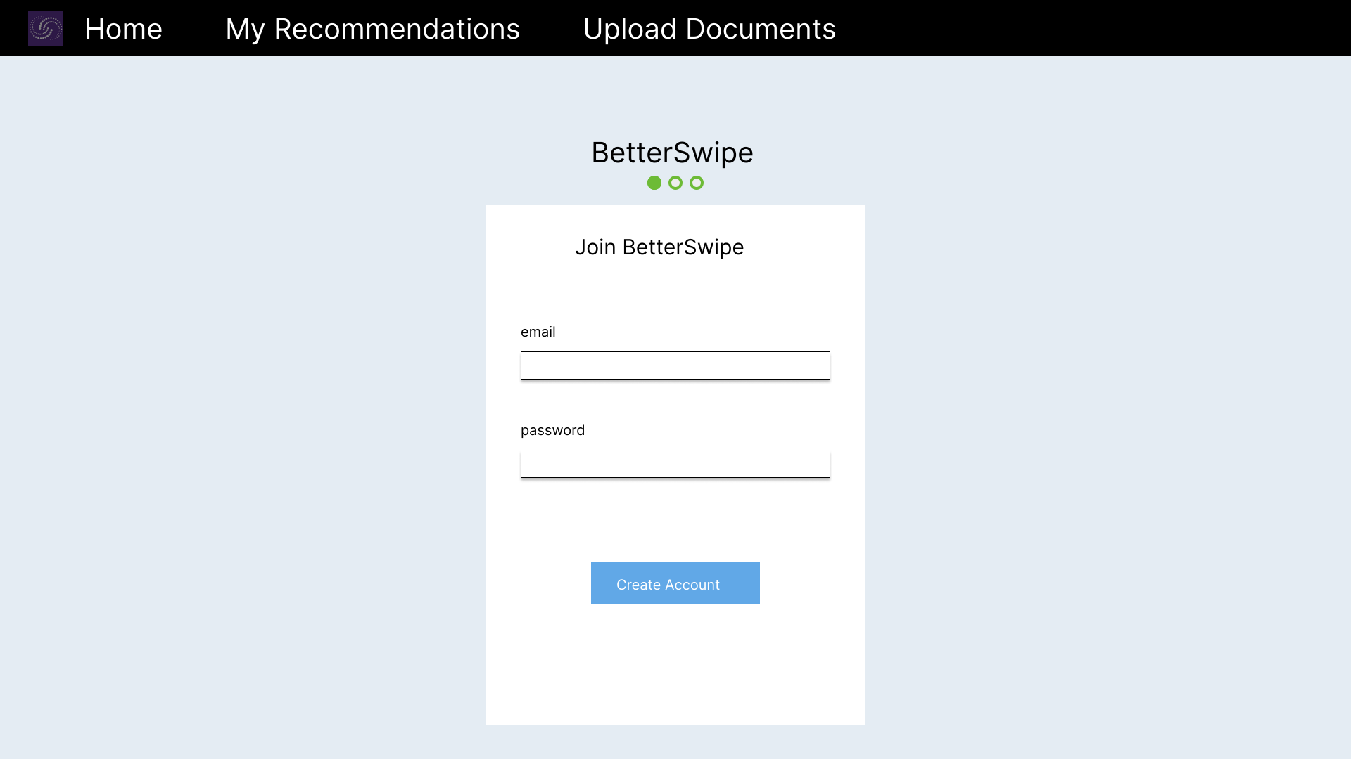
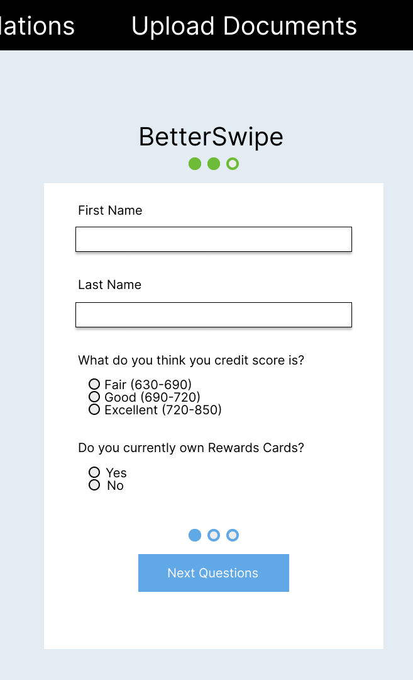
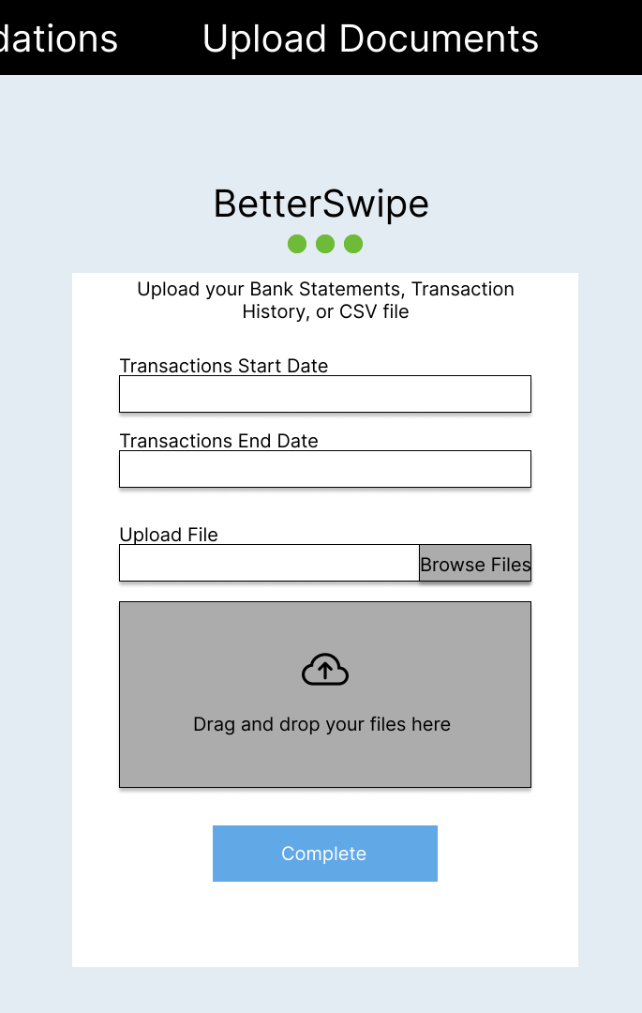
Registration Pages

Slide 19
Algorithms
Create profile
Load Statements
Analyze spending profile
Find top matches
Create new account
Read statement file
Calculate spending category averages
Calculate card scores
Log in
Parse spending data
Sort by highest score
Categorize using AI/ML
Return top 3 to GUI

Slide 20
WBS Algorithms - Create Profile
Start
No
Is there a profile associated with user Email?
User inputs basic user information to create account: email, user name, password,
Valid password and adequate data for user account?
Prompt user to log in
User begins profile creation
No
Yes
Yes
Valid password for that account?
Request user to log in again
No
Yes
Log into user account
User account created and entered into database.

Slide 21
WBS Algorithms - Load Statements
No
User prompted to input bank statements
Valid File Type?
Parse Text
Interpret each line as a transaction
Start
Yes
Has the Last transaction in the list been categorized?
Read transaction and place into a category using Machine Learning
Save transaction to spending profile in database
Yes
Finish
No

Slide 22
WBS Algorithms - Analyzing Spending Profile
Has the Last transaction in the list been categorized?
Read transaction from database
Create a list of average sums for each category per month
Add to the cost sum of the category
Yes
Return Category averages
Start
No

Slide 23
WBS Algorithms - Finding Top Matches
Read averages for every category from user Spending Profile
List of rewards from credit cards
Plug in averages of categories to each credit card
Start
Add value of rewards to list of rewards from credit cards
Sort list by value of rewards
Return the top 3 cards

Slide 24
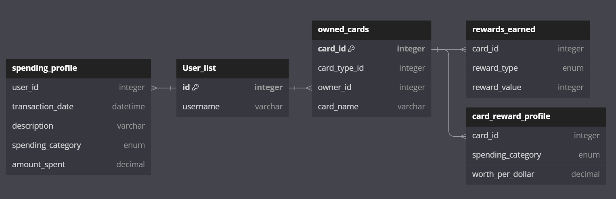
Database Structure

Slide 25

Data Management

Slide 26
Testing
Software
Functional
Non-Functional
Units
Performance
Integration
Security
System
Usability
Acceptance
Compatibility

Slide 27
Hardware and Software
Hardware
Network-Accessible Devices
PCs
Smartphones
Server system(s) required for hosting
Software
Repository: Github
Database: MySQL
MFA: Duo
Languages: Python, HTML, CSS, Javascript
Machine Learning: Tensorflow

Slide 28
Development Tools
Category | Application
Version Control | Git/Github
Issue Tracking | Trello
Languages | HTML/CSS/JS/Python
Database | MySQL (Amazon RDS)
IDEs | Visual Studio
Components/API | RewardsCC API
Testing | pytest

Slide 29
Agile Sprints
Sprint 0
Account Roles/Authentication
DB/ML Setup
User Interface Setup
Bank Statement Generation
Sprint 2
Card Recommendations
Expenditure Dashboard
Incorporate User Information
Sprint 4
Predictive Savings Analysis
User Historical Comparison
Sprint 1
Manual Statement Upload
Data Categorization
API Integration
Encryption
Sprint 3
Rewards Reminder System
Automated Statement Upload

Slide 30
Security Risk Matrix
Security Risks | Mitigations
S1.Risk of Personal Identifiable Information (PII) and sensitive information
S1. Follow standards for protecting PII according to National Institute of Science and Technology Privacy Framework
S1. Encrypt data-at-rest and in-transit
5 Very Likely
4 Likely
3 Possible
2 Unlikely
1 Very Unlikely
 |  | S3 | S2 | S1
 | S3 | S2 | S1
Probability
1 insignificant 2 minor 3 moderate 4 significant 5 catastrophe
Impact
S2. Unauthorized profile access
S2. Implement MFA, strong password requirements, and salt password hashes
S3. Use of API(s)
S3. Implement API Gateway and SSL/TLS

Slide 31
Customer Risk Matrix
Customer Risks | Mitigations
C1. Customer does not find satisfactory solution
C1. Test thoroughly for multiple profile cases
C2. Customer adds erroneous inputs
C2. Implement input validation and allow user to confirm choices
C3. Customer chooses card(s) they are not approved for
C3. Allow for user to input estimated credit score and cards they own
5 Very Likely
4 Likely
3 Possible
2 Unlikely
1 Very Unlikely
 | C1 | C2
 | C3
 | C1 | C2
 | C3
Probability
1 insignificant 2 minor 3 moderate 4 significant 5 catastrophe
Impact

Slide 32
Technical Risk Matrix
Technical Risks | Mitigations
T1. App unable to access API(s)
T1. Test API(s) and cache responses
T2. Data from credit card providers not up to date
T2. Consistently monitor API(s) for updates and implement most up-to-date card information
5 Very Likely
4 Likely
3 Possible
2 Unlikely
1 Very Unlikely
 |  |  | T1
 |  | T2
 | T2 |  | T1
Probability
1 insignificant 2 minor 3 moderate 4 significant 5 catastrophe
Impact

Slide 33
Competition Matrix
Product Category | Better Swipe | NerdWallet | Bankrate | Finder
Rate Cards | ❌ | ✅ | ✅ | ✅
Search for “best” of each type | ✅ | ✅ | ✅ | ✅
Tailor cards based on credit score | ✅ | ✅ | ✅ | ✅
Match cards based on intention | ✅ | ✅ | ✅ | ❌
Match cards based on spending profile | ✅ | ✅ | ✅ | ❌
Compare cards side by side | ❌ | ✅ | ❌ | ❌
Continuous monitoring for lifestyle changes | ✅ | ❌ | ❌ | ❌
Reminders for reward use | ✅ | ❌ | ❌ | ❌
Automatic bank statement input | ✅ | ❌ | ❌ | ❌

Slide 34
Constraints
Will not check users’ credit scores
Will not apply to a given card for the user
Will not manage how user utilizes chosen card(s)

Slide 35
Conclusion - Key Points Summary
Searching for credits cards has become problematic over the years with the addition of credit card rewards.
The differences between credit card rewards and their quantity are what make this issue a problem to be solved.
BetterSwipes goal is to make this process easier and allow people to find a credit card tailored to their needs.
Using Machine Learning to read bank statements to tailor credit card options.
Educating customers on how to properly using credit cards for their benefit.
There is some risk in BetterSwipe.
Potential for user information being wrongly accessed and leaked.
Constant monitoring of card information for updates.

Slide 36
“Better Rewards, Better Savings, Better Swipe”
Questions?

Slide 37
References
Akash Chauhan, & Anshu Goal. (2023). Comparative study between debit card & credit card users in Greater Noida City.
Bankrate. (n.d.). Are rewards credit cards worth it?, from https://www.bankrate.com/finance/credit-cards/are-rewards-credit-cards-worth-it/#pros-cons
Bankrate. (n.d.). Are rewards credit cards worth it?, from https://www.bankrate.com/finance/credit-cards/are-rewards-credit-cards-worth-it/#pros-cons
Bankrate. (n.d.). How to choose a rewards credit card., from https://www.bankrate.com/finance/credit-cards/choose-rewards-credit-card/
Capital One. (2023). Venture. Retrieved from https://applynow.capitalone.com/?irgwc=1&external_id=IRAFF_ZZce293c61587c41c29a64c5685cb78e40_USCIR_K170911_A344893L_C0bcf2f83N684a11ee9b4547fc6474d6a_S_P&transid=&marketingChannel=P23235&oC=COh7rTP9h&productId=24919
Credit Karma. (2023). Compare credit cards &amp; apply online instantly. Intuit Credit Karma. https://www.creditkarma.com/credit-cards/search-cc

Slide 38
References
Chase. (2023). Sapphire Preferred. Retrieved from https://creditcards.chase.com/a1/23Q3a/sapphirepreferred/compare?CELL=6H8X&AFFID=SWlnSnn6x54-uFq.wEnPmd6AIGJp3kVUng&pvid112b6c9a7e784f3fba5eec3490744a4b&jp_cmp=cc/1431835/aff/15-31715/na
Dodgson, L. (2018, October 4). Why Too Much Choice Is Bad. Business Insider. https://www.businessinsider.com/why-too-much-choice-is-bad-2018-10
DOI.org. (2023). International Journal of Finance and Managerial Research, 05(03). https://dx.doi.org/10.36948/ijfmr.2023.v05i03.2874
Experian. (2017). Survey Findings: How Do Consumers Feel About Credit Cards? https://www.experian.com/blogs/ask-experian/survey-findings-how-do-consumers-feel-about-credit-cards/
Fontinelle, A. (2021, May 17). Credit Cards vs. Debit Cards: What's the Difference? Investopedia. Retrieved October 11, 2023, from https://www.investopedia.com/articles/pf/10/credit-card-debit-card.asp
GÜL, Z., & İŞCAN, O. (2022). Understanding Consumer Behavior towards Credit Card Usage in Bangladesh. ISARDER. Retrieved October 11, 2023, from https://isarder.org/index.php/isarder/article/view/1693/1642

Slide 39
References
Kurien, R., Paila, A. R., & Nagendra, A. (2014). Application of paralysis analysis syndrome in customer decision making. Procedia Economics and Finance, 11, 323-334.
Lambright Black, M. (2022, August 15). Study: Millions Leave Credit Card Rewards Unredeemed. LendingTree. Retrieved October 11, 2023, from https://www.lendingtree.com/credit-cards/study/unused-rewards/
NerdWallet. (2023). What’s the Value of Capital One Miles? Retrieved from https://www.nerdwallet.com/article/travel/capital-one-miles-value#:~:text=Capital%20One%20miles%20are%20worth,transfer%20partners%20at%201.4%20cents.
NerdWallet. (2023). What’s the Value of Chase Ultimate Rewards Points? Retrieved from https://www.nerdwallet.com/article/travel/chase-ultimate-rewards-points-value#:~:text=Based%20on%20our%20most%20recent,Ultimate%20Rewards%C2%AE%20redemption%20options.
NerdWallet. (2023, July 7). How to Read the Schumer Box on a Credit Card. Retrieved October 11, 2023, from https://www.nerdwallet.com/article/credit-cards/how-to-read-schumer-box

Slide 40
References
The Motley Fool. (2020). Credit and Debit Card Market Share by Network and Issuer. Retrieved from https://www.fool.com/the-ascent/research/credit-debit-card-market-share-network-issuer/
Pokora, B. (2023, March 9). Credit Card Statistics: 23 Must-Know Data Points for 2023. Forbes. Retrieved October 11, 2023, from https://www.forbes.com/advisor/credit-cards/credit-card-statistics/
ScienceDirect. (2014). The Effect of Too Many Choices on Consumer Satisfaction in Online Sales Environments. https://www.sciencedirect.com/science/article/pii/S2212567114002007/pdf?md5=26ae6e12a34221c1f26fe30622eafbee&pid=1-s2.0-S2212567114002007-main.pdf&_valck=1
Wells Fargo. (2023). Wells Fargo Active Cash Card. Retrieved from https://creditcards.wellsfargo.com/cards/active-cash-credit-card/?product_code=CC&subproduct_code=AC&FPID=0126D7IDF40000&vendor_code=LS&sub_channel=AFF&siteID=SWlnSnn6x54-VBFI3LHxdVpqwHmPYdNihg

Slide 41
Image Source
https://shourai.io/blog/2020/07/17/web-application-development-the-basic-concepts/
https://www.allerin.com/blog/what-is-mobile-app-integration
https://credit.org/blog/the-benefits-of-having-credit-cards/
https://www.quicken.com/goals/see-where-my-money-is-going/
https://www.usatoday.com/money/blueprint/credit-cards/how-many-credit-cards-should-i-have/
https://www.google.com/url?sa=i&url=https%3A%2F%2Fwww.sharecare.com%2Fmental-health-behavior%2Fstress-management%2F8-warning-signs-of-too-much-stress&psig=AOvVaw3YHRcYnBJ3YixeBKOiTGpJ&ust=1697662494403000&source=images&cd=vfe&opi=89978449&ved=0CBAQjRxqFwoTCLCTv-T7_YEDFQAAAAAdAAAAABAL

